Slide 1

OLIST
  PERFORMANCE
  ANALYSIS

Slide 2
Team Members
  Names:- MaiI ID:-
Mahek Shaikh shaikhmahekmohsin@gmail.com
Rakshitha T J rakshadhanu15@gmail.com
Aryan Barot aryanmbarot1169@gmail.com
Talamarla Giridhar Gowd talamarlagiridhar@gmail.com
Krishna Kishor B.K krishnakishor764@gmail.com
Dr Vichitra Somashekar vichitrasomshekar23@gmail.com
Patibandla Sai Kushal patibandlasaikushal@gmail.com

Slide 3
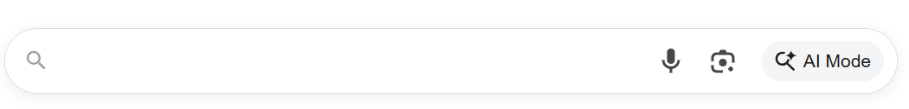


OLIST
Olist dashboard performance analysis
RECENT SEARCHS
Weekday vs weekend payment statistics
Orders with review score 5 and payment type credit card
Average number of days taken to delivery for pet shop
Average price and payment values from customers of sao Paulo city
Relationship between shipping days vs review score

Slide 4
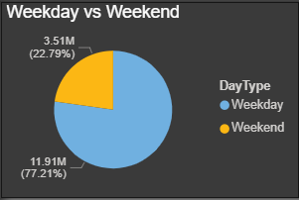
Weekday vs weekend payment statistics
The Purpose of this chart is :To show the proportion or percentage distribution of the total orders that occurs on weekdays VS weekends. This helps in understanding the daily orders pattern.
Weekday: Represents the orders that occurring during the week Value: 11.91 Million (M), accounting for 77.21% of the total.
Weekend: Represents the orders occurring during the weekend Value: 3.51 Million (M), accounting for 22.79% of the total.

Slide 5
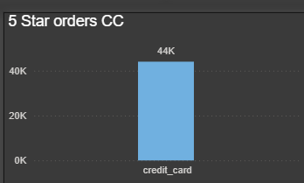
Orders with review score 5 and payment type credit card
The Purpose of this chart is : to quantify the number of top-rated orders (specifically 5-star) that utilized the credit card payment option It helps in assessing the popularity or usage of this payment method for high-quality transactions
Credit Card: Represents the count of 5-star orders paid for using a credit card Value: 44K
The chart indicates that 43,981 five-star orders were processed using a credit card

Slide 6
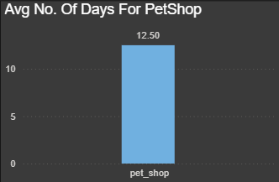
Average number of days taken to delivery for pet shop
The Purpose of this chart is : To display the average number of days associated with the “Pet Shop" category This is often used to track cycle time, fulfillment duration, or frequency.
Pet Shop: Represents the average number of days for this category Value: 12.50 days.

Slide 7
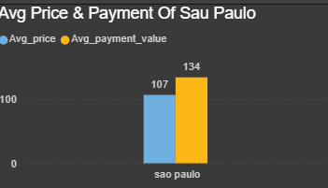
Average price and payment values from customers of sao Paulo city
The Purpose of this chart is : To compare the average price versus the average payment value for transactions originating from São Paulo City This helps identify if there's a difference between what the item is priced at and the final amount paid
Average payment value (Yellow Bar): The average amount received in payment. Value: 134.
Average price (Blue Bar): The average selling price Value: 107.
The average payment value (134) in Sao Paulo is significantly higher than the average price (107), suggesting that additional costs like shipping, taxes, or service fees are consistently added to the price

Slide 8
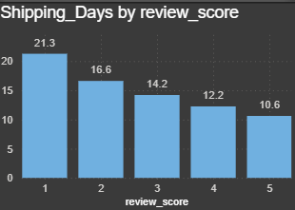
Relationship between shipping days vs review score
The Purpose of this chart is : To show the relationship between shipping time and customer satisfaction Specifically, it plots the average number of shipping days against the corresponding customer review score (1 to 5)
Y-Axis (Shipping Days): The average delivery time in days.
X-Axis (Review score): The customer rating (1 being lowest, 5 being highest).
There is a clear negative correlation (inverse relationship): Lower review scores have the longest average shipping time (21.3 days)
Higher review scores have the shortest average shipping time (10.6 days).
This suggests faster shipping leads to better reviews

Slide 9
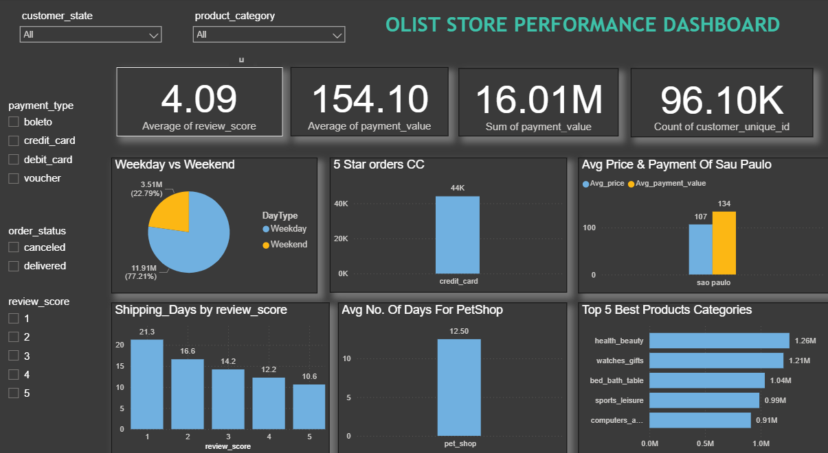
PowerBI dashboard

Slide 10
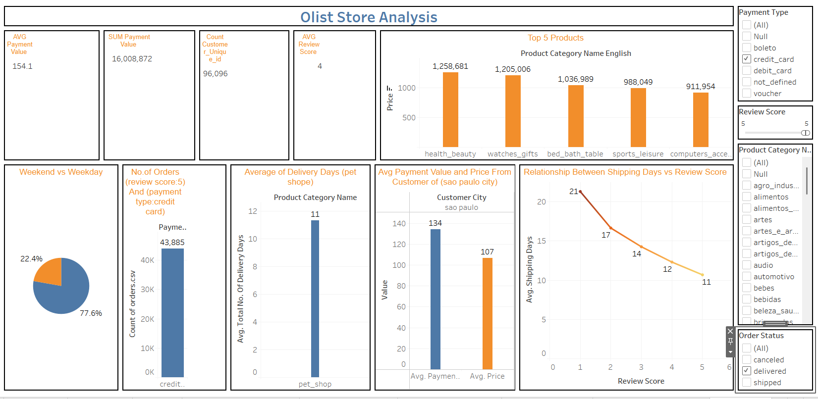
Tableau dashboard

Slide 11
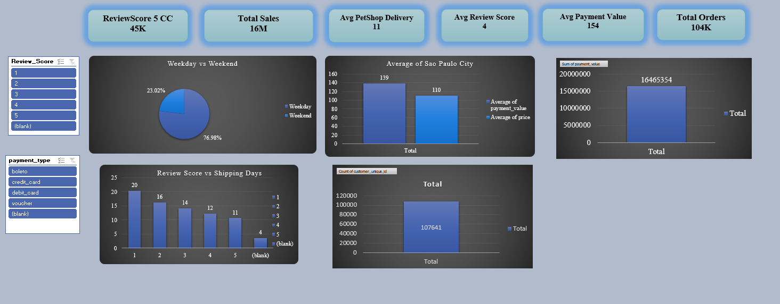
Excel dashboard

Slide 12
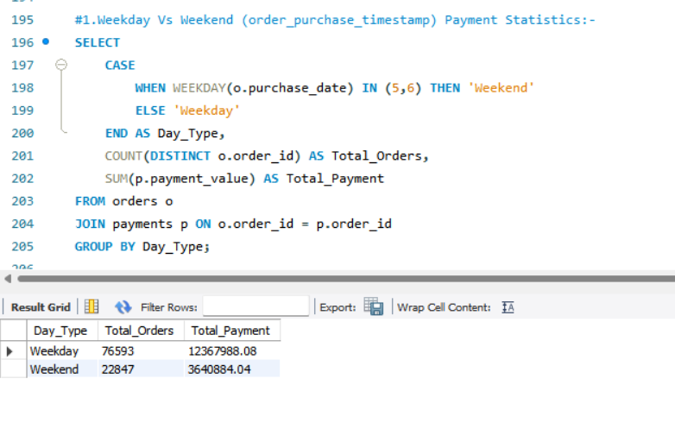
SQL quires

Slide 13
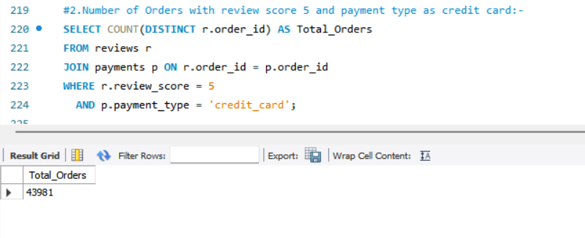
SQL quires

Slide 14
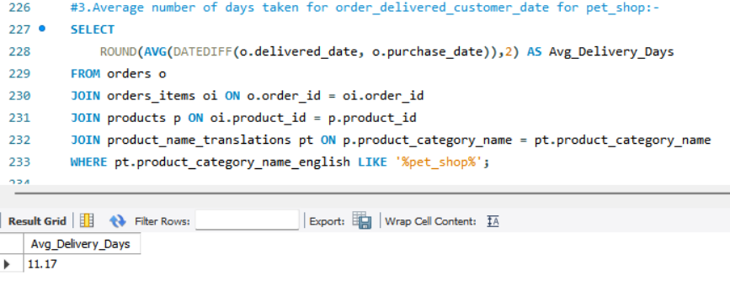
SQL quires

Slide 15
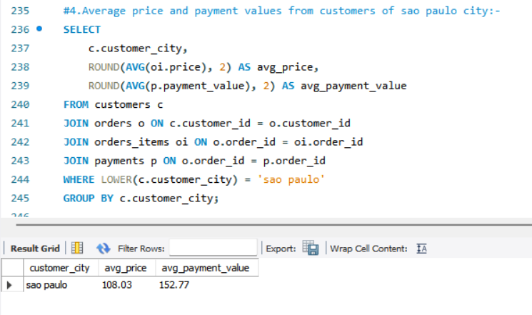
SQL quires

Slide 16
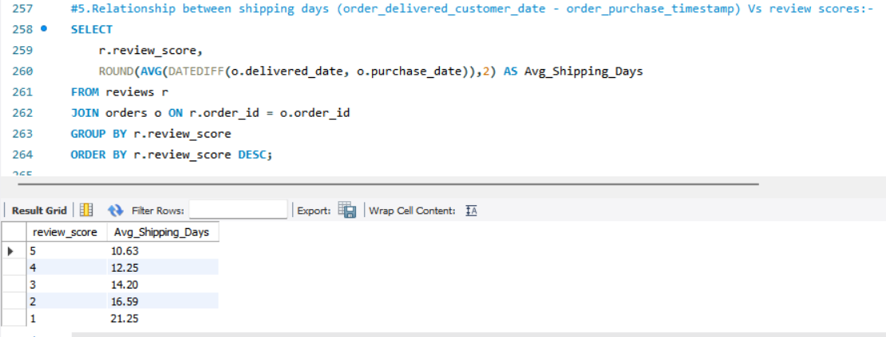
SQL quires

Slide 17
Conclusion
The analysis reveals several critical performance metrics and patterns for the Olist store, particularly highlighting the strong correlation between shipping speed and customer satisfaction, and key sales/payment behaviors
The primary takeaway is that operational efficiency, particularly in reducing shipping days, is the most direct lever available to improve customer review scores and, by extension, overall business health

Slide 18
Thank You

